Slide 1
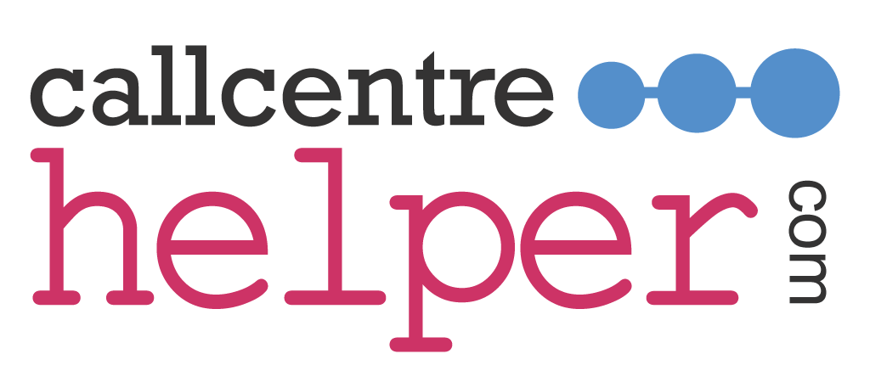
Original Comedy Phonetic Alphabet
A | A is for Horses (Hay is for Horses)
B | B for Mutton (Beef or Mutton)
C | C for Islanders (Seaforth Highlanders)
D | D for Ential (Deferential)
E | E for Adam (Eve or Adam)
F | F for Vescence (Effervescence)
G | G for Police (Chief of Police)
H | H for Respect (Age for Respect)
I | I for Novello (Ivor Novello)
J | J for Oranges (Jaffa Oranges)
K | K for Answers (Kay Francis)
L | L for Leather (Hell for Leather)
M | M for Sis (Emphasis)
N | N for A Dig (In for a Dig)
O | O for The Garden Wall (Over the Garden Wall)
P | P for Penny (Pee for a Penny)
Q | Q for Song (Cue for Song)
R | R for Mo (Half a Mo')
S | S for You (It’s for You)
T | T for Two (Tea for Two)
U | U for Films (You for Films?)
V | V for La France (Vive La France)
W | W for A Bob (I'll double you for a Bob)
X | X for Breakfast (Eggs for Breakfast)
Y | Y for God’s Sake (Why for God’s Sake)
Z | Z for Breeze (Zephyr Breeze)

