Slide 1
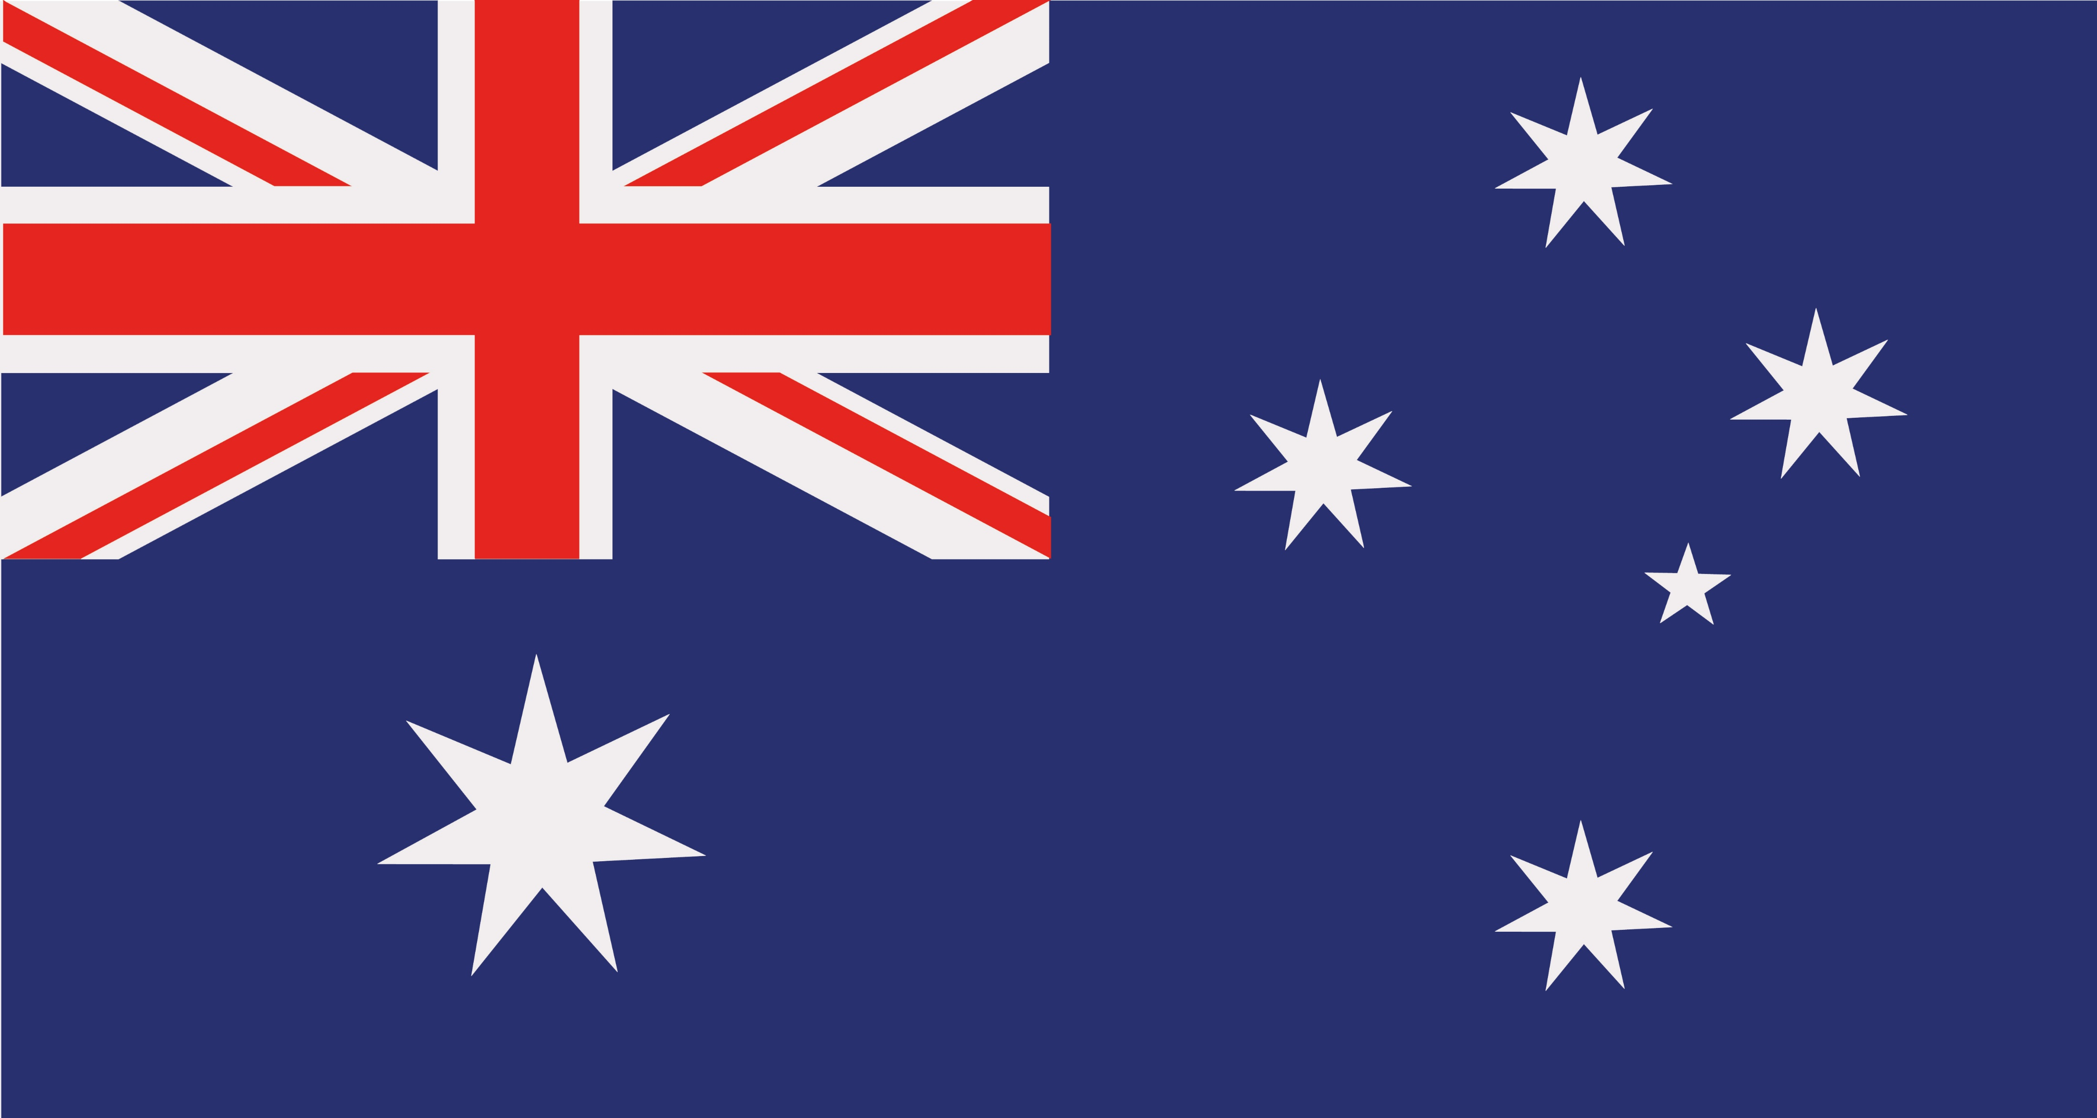

Funny Australian Phonetic Alphabet
A | AUSTRALIA
B | BRUCE
C | CRIKEY
D | DUNNY
E | EMU
F | FOOTIE
G | G’DAY
H | HOTEL
I | IFFY
J | JELLYFISH
K | KANGAROO
L | LYREBIRD
M | MELBOURNE
N | NEMO
O | OUTBACK
P | PERTH OR PLATYPUS
Q | QUEENSLAND
R | ROO
S | SHEILA
T | TINNY
U | ULURU
V | VICTORIA
W | WOMBAT
X | X-RAY
Y | YABBY
Z | ZULU

